Slide 1
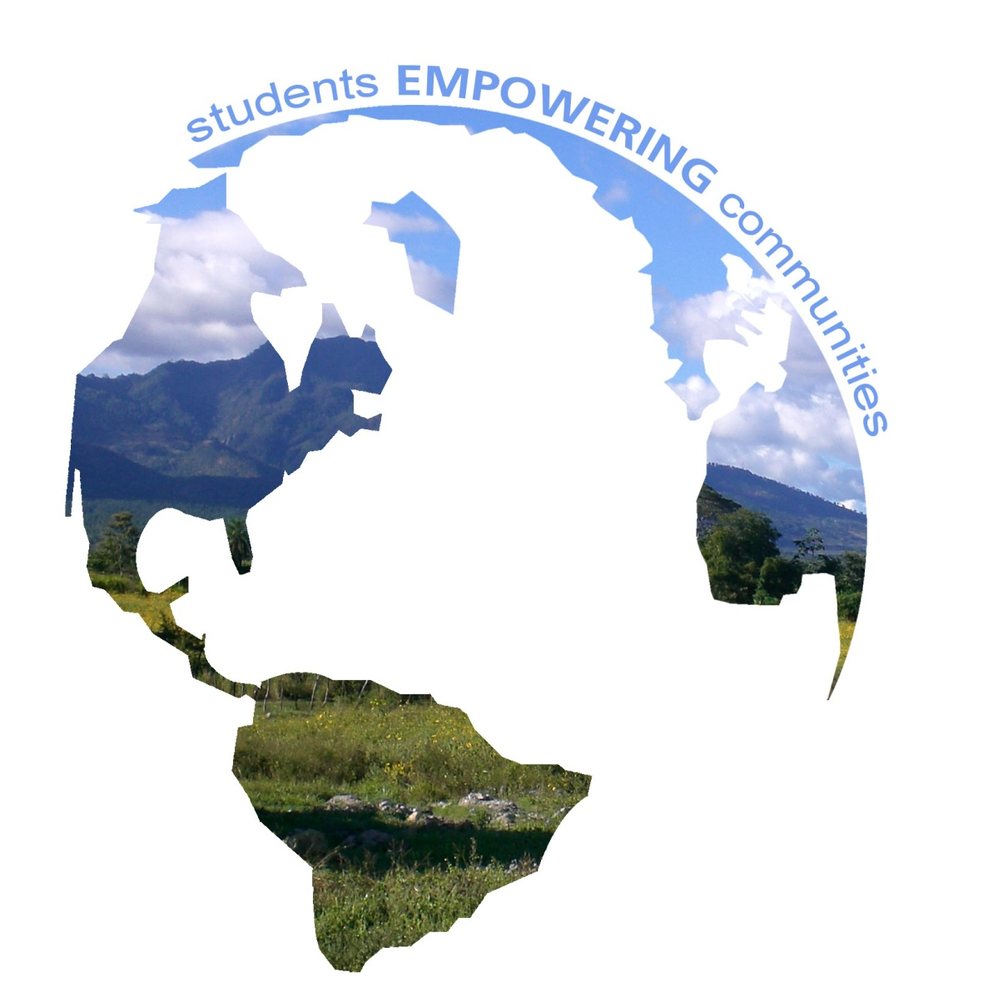
October 14, 2010
Meeting #2

Slide 2
Today
Deadlines
Upcoming fundraisers
Proposal and community talk
Development discussion

Slide 3
Travel Deadlines
November 14
$650 total submitted to brigades.org
Required for booking your flight

Slide 4
Upcoming Fundraisers
November 11th --- Cancelled
Not enough interest
Canning
November 6th – sign up with Jesse

Slide 5
Verifcation
Check to make sure that your departure and arrival cities are correct
Figure out your passport number and email to sprodhan@indiana.edu by next Friday (the 12th)

Slide 6
Panama
Facts about Panama:
Panama has the second most un-equal income distribution in Latin America.
About 30% of the population lives in poverty, primarily concentrated in rural areas. The wealthiest 20% of Panamanians control more than 50% of the country's wealth, while the poorest 40% only control 12%.
About 17% of the overall population is undernourished and almost half of all Panamanian children are poor.
Overall, 7.4% of the population is living on less than $1 a day.
Major Exports include: Banana, shrimp, sugar and coffee.

Slide 7
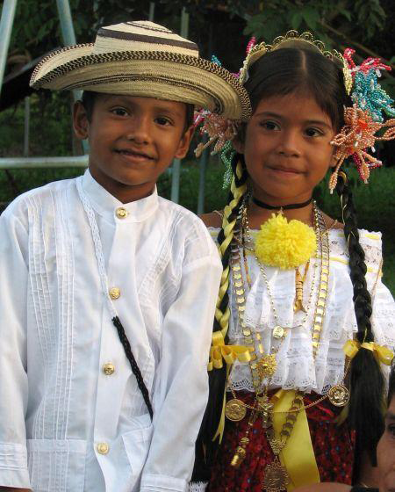
New Project
The Community: El Entradero, Anton. Coclé
It is located a distance of 32 km from the city of Anton in an area close to the Cordillera Central, 600 m above sea level, where it rains 9 months of the year and where stem 2 of the major rivers of that district: Rio Chorrerita and La Estancia. It also has 23 small streams and 7 intakes that provide potable water service catering to the surrounding communities.

Slide 8
Map
Distance between Panama City and Cocle: 2.5 hours
Average temp year round: 80 degrees Fehrenheit

Slide 9
Progress in El Entradero
About 36 families have planted about 20, 000 m², between corn, beans and rice with sustainable farming techniques.
Of all the communities SHI works with, El Entradero, has been the one with the highest amount of reforestation. They established a greenhouse with a total of 3,750 tree seedlings which were planted in July.
Just from April to June they produced almost 14,000 pounds of organic fertilizer to improve soil fertility and productivity of crops in an environmentally friendly way. Most families have accepted the organic system, though there are some families who still do not. stop
They prepared about 27 gallon of insecticide made out of natural repellents such as chili pepper.

Slide 10
Our partner
Sustainable Harvest International (SHI)
Working in Panama and Nicaragua since 1997
Using organic vegetable gardens, wood-conserving stoves, biogas digesters and a host of other projects
In the last year, SHI-Panama participants successfully converted 59 acres to sustainable land use practices, while reforesting 22 acres with 15,986 trees!

Slide 11
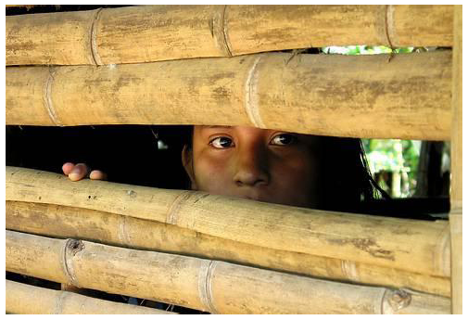
Cultural Background
Inadequate social services
Child labor
Inadequate education poor Spanish speaking skills
Etc…

Slide 12
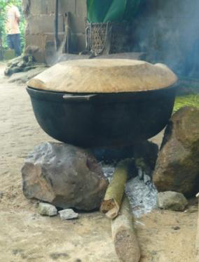
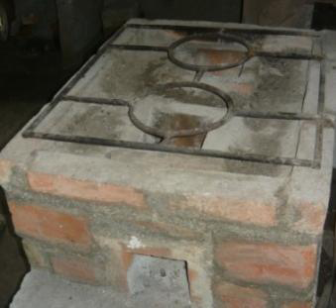
The problems of the community
Deforestation: Tackle with eco-stoves!
Indoor pollution
Water quality
GOOD
BAD

Slide 13
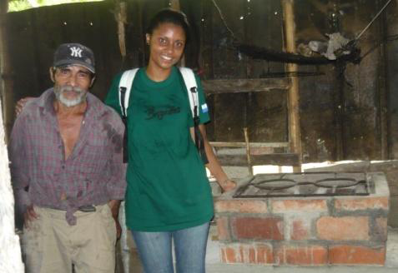
What are WE going to do???
ECO-STOVES!!!
Slow-sand Water Filtration System!
Environmental Education!!
2-3 workshops to 20-30 of the community members

