Slide 1
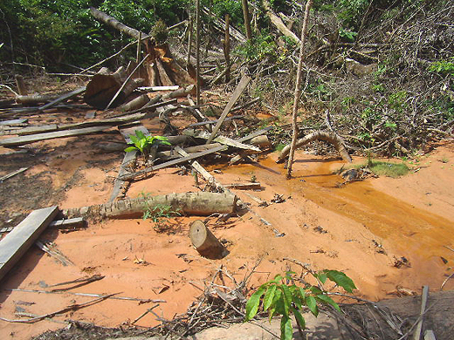
Tourism and Environmental Destruction

Slide 2
“Between 1995 and 2007, world tourism increased at an average of 4.2% annually, and this trend is expected to continue until 2020.” -(Mapes 225)

Slide 3
3 Types of Tourist
“Casual Traveler”
Cruise ship passenger
All-inclusive resort guest
Unlikely to seek out “eco friendly opportunity”
Expeditions
Week or longer stay
More interested in authentic culture/ecology
Public-private partnerships
Adventure, relaxation, and education tourism
“Immersion Tourist”
Young, budget conscious, stay in low cost hostels
Lower net impact on environment

Slide 4
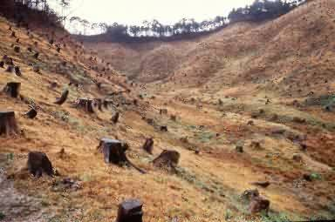
Overuse of resources
Water
Swimming pools, golf courses, personal use by hotel guests
Over-pumping from wells causes “saline intrusion”
Increase in waste water
Deforestation
Land clearing, logging for fuel and building materials

Slide 5
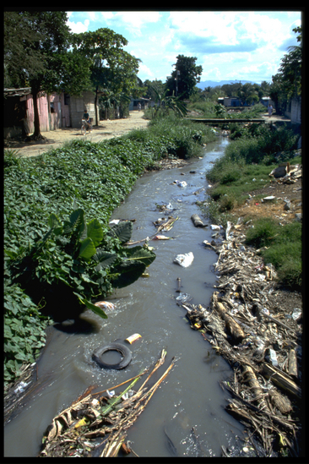
Pollution
Improper waste disposal
Sewage, garbage, etc.
Expeditions by tourists
Littering

Slide 6
Panama
Soil Erosion
2,000 tons per year
Deforestation
Losing approximately 1% of its forests per year
Land clearing
Expanded agricultural frontiers
Colonization
Industry-caused pollution
Only 7% of rural Panamanians have pure drinking water

Slide 7
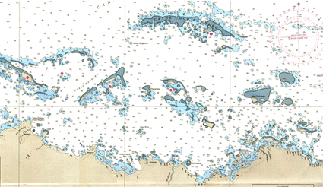
Comarca de Kuna Yala
Archipelago containing more than 400 islands and a narrow coastal region
Difficult to reach by tourists
Frequented by cruise ships
“Indigenous Tourism”
Mola production (layered, intricately designed pieces of fabric) stimulate tourist economy.

Slide 8
Benefits of Tourism
Financial contributions
Raise awareness of problems and the direct effect of environmental depletion on people and wildlife

Slide 9
What is being/can be done
Green tourism management/planning
Energy efficient construction materials
Clean waste removal/disposal
Local community involvement in Ecotourism
Visiting medicine man, grinding cacao beans, watching traditional dances, bird watching, authentic craft purchase
More regulation on industries to act sustainably

Slide 10
Sources
www.gdrc.org/uem/ecotour/envi/index.html
www.nationsencyclopedia.com/Americas/Panama-ENVIRONMENT.html
“EXPANDING ECOTOURISM: EMBEDDING ENVIRONMENTAL SUSTAINABILITY IN PANAMA’S BURGEONING TOURIST INDUSTRY” by Katharine Mapes

