Slide 1
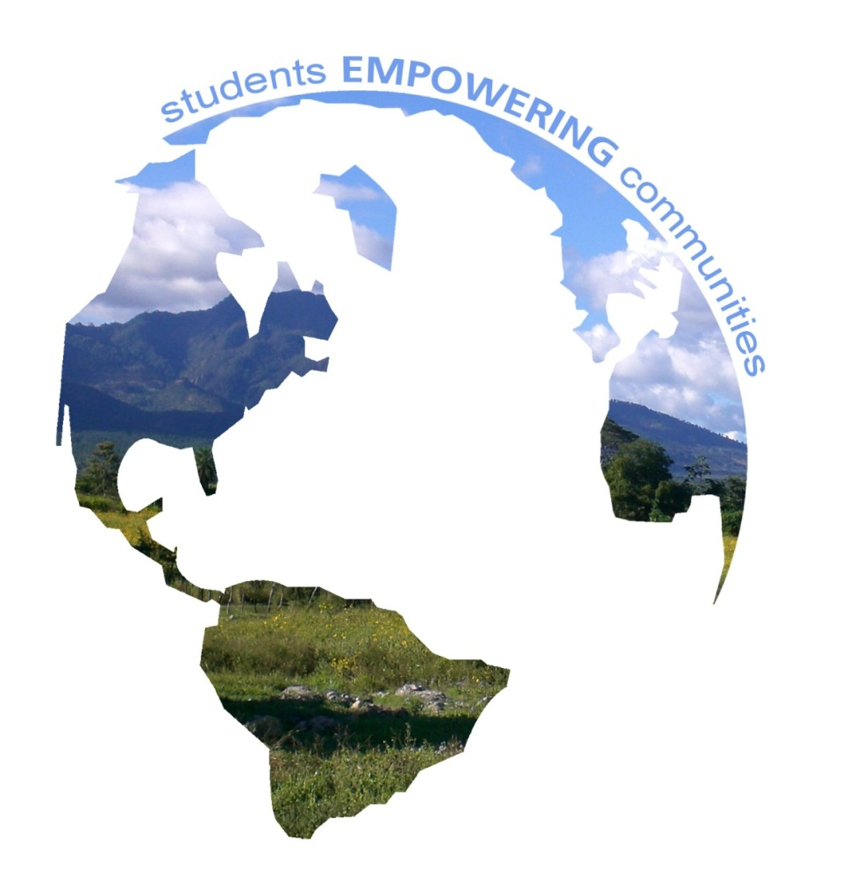
Environmental Brigades
INDIANA
student-led international development
students EMPOWERING communities
www.globalbrigades.org

Slide 2
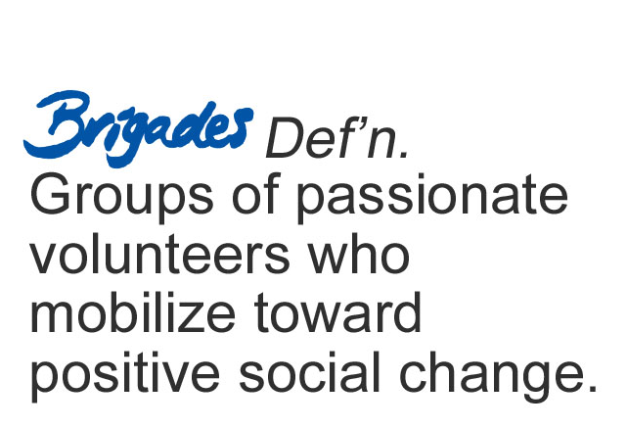
BRIGADES DEFINITION
Global Brigades, Inc. Copyright 2009

Slide 3
OUR VISION
VISION-International To create the world’s largest student-led movement for international sustainable development
VISION-On our campus
To create a well rounded, multidisciplinary student-run club dedicated to providing sustainable development solutions in Honduras and Panama
Notes:
STRAIGHT FROM BYLAWS:
The growing global economy has provided opportunity and affluence for those that can tap into it, but for many, opportunity is out of reach due to infrastructural gaps and access to resources. As a result, we are witnesses to a growing disparity of wealth and quality of health and education between the affluent sects of our global community and nearly everyone else. The disparity is most extreme in developing countries with infrastructural disadvantages that make them most at risk of experiencing a never-ending cycle of poverty, hunger and lack of health care.
In response to this disparity of quality of life, Global Brigades, Inc, (Global Brigades) intends to ignite the largest student-led social responsibility movement on the planet; with the mission to empower students to facilitate sustainable solutions in developing countries while respecting local cultures.

Slide 4
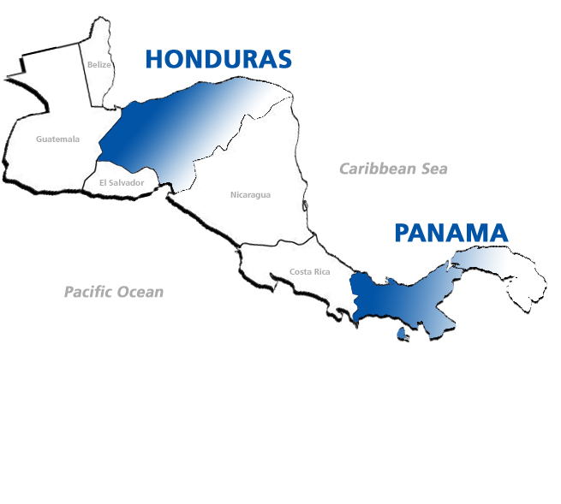
Global Brigades, Inc. Copyright 2009
Typical family income is less than
$2 per day
Typically no doctors within a 20 mile radius
Average level of education is
approximately 5th grade
Typical families have less than 3 gallons of water per day to use
Areas of high biodiversity at risk
of environmental degradation
Notes:
DID YOU KNOW?
Panama has the 4th highest wealth disparity in all of Latin America and 1st highest in all of Central America
For 2007, 56.8% of the unemployed Hondurans have done up to elementary school. The relationship between education-income per capita in a household is $53 for someone who has had elementary school education, while if the head of the family has received a superior education the income can be up to $391.
As of 2003, 49% of all Panamanians and 57% of all poor in Panama are citizens less than 20 years old increasing a dire need for more youth opportunity

Slide 5
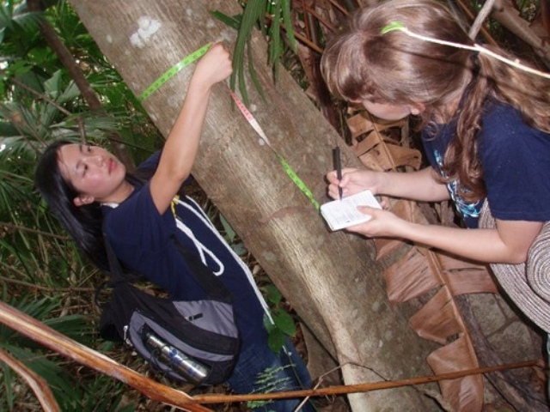
Environmental Brigades develops sustainable environmental solutions to preserve natural resources in bio-rich, but economically disadvantaged communities. In conjunction with local leaders and international organizations, student volunteers plan and implement projects that help communities develop sustainably and protect their future. Student projects include alternative energy solutions, reforestation and ecological preservation, environmental consulting to developing businesses and endangered species protection.
Notes:
Environmental Brigades develops sustainable environmental solutions to preserve natural resources in bio-rich, but economically disadvantaged communities. In conjunction with local leaders and international organizations, student volunteers plan and implement projects that help communities develop sustainably and protect their future. Student projects include alternative energy solutions, reforestation and ecological preservation, environmental consulting to developing businesses and endangered species protection. Currently, Environmental Brigades is only offered in Panama.

Slide 6
PROGRAM COSTS
Global Brigades, Inc. Copyright 2009
$850 USD + Airfare
Included in program fee:
8 days and 7 nights program
Accommodations and meals
In-country transportation
Spanish translators and coordinators
Program sustainability and follow-up by in-country team
Community investment fund to perpetuate projects
Health insurance
Experience of a life time!

Slide 7
WHY GET INVOLVED
Global Brigades, Inc. Copyright 2009
An opportunity to learn:
Get real world experience in your field of interest
Challenge what you have learned in the classroom
Meet other students with similar interests and passions
Practice Spanish
See the beauty of Central America!
An opportunity to help:
Use your education and your resources to change lives
Provide basic resources and sustainable development projects that will help communities for generations to come
See how much you can get done in only one week
Past Brigaders: Share your stories and your experiences!

Slide 8
More about Environmental Brigades
3 PRINCIPLES
Work to support life-sustaining ecosystem services by preserving natural systems, protecting biodiversity, and recuperating degraded environments
Develop solutions that also protect natural resources and protect human health
Work alongside community members to promote sustainable practices

Slide 9
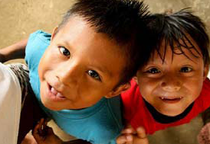
POPULATION
POPULATION
Indigenous people of Kuna
Rural Panamanian villages several hours outside of Panama City, Panama
0-14 years: 29.3%
15-64 years: 63.9%
65 years and over: 6.8%

Slide 10
COMMUNITIES
Incredibly isolated
Lack social services and communication with outside world
Lack financial resources
Overuse limited resources

Slide 11
ABOUT THE LAND
Youngest land in the Americas
Incredibly biodiverse
10,000+ varieties of plant
1000+ species of birds

Slide 12
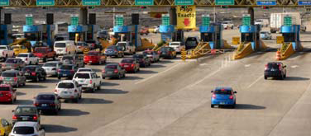
PROBLEMS
HUGE economic boom in 1999 ushered by the control of the Panama Canal
Brought producers and consumers from all over the world to the city
Unfortunately, no opportunities outside of the city

Slide 13
ENVIRONMENTAL PROBLEMS
Past:
3-10 million years ago = rise of isthmus
Pacific and Atlantic no longer touch
Water grew warmer
Present:
Deforestation
Flooding
Overuse of resources

Slide 14
PROJECT FOCUSES
Native species reforestation
Energy-efficient design including solar panels and compost toilets, eco-tourism, conducting studies, GPS mapping, recycling efforts, organic/sustainable agriculture capacitation
Building of an environmental education curriculum

Slide 15
ON-CAMPUS ACTIVITIES
Bi-monthly meetings
Canning fundraisers twice a month
Big fundraiser once a month
Promotion of environmental problems to campus community

Slide 16
SPECIFICS ABOUT IU
Trip Date: January 2 – 9, 2011
Maximum capacity: 25 students
Final Online Registration Date and $20 deposit: October 15, 2010
First $250 deposit: October 15, 2010
Final payment: December 15, 2010

Slide 17
Fundraising
Hutton
Local rotary club
Pre-made letters on iugeb website
Facebook group
Participate in our fundraisers

Slide 18
Upcoming Fundraisers
September 25, 2010
Canning at Brothers (9pm – 12am)
October 2, 2010
Canning at Brothers (9pm – 12am)
October 5, 2010
Noodles Dine-to-Donate

Slide 19
NEXT STEPS
Global Brigades, Inc. Copyright 2009
Fill out membership application
2. Deadline for website registration – October 13, 5:00 PM
Make a $250 deposit by October 13th deadline

Slide 20
Iugeb.weebly.com
ARCHITECTURE.BUSINESS.DENTAL.ENVIRONMENT.LAW.MEDICAL.MICROFINANCE.PUBLIC HEALTH.WATER
www.globalbrigades.org

