Slide 1
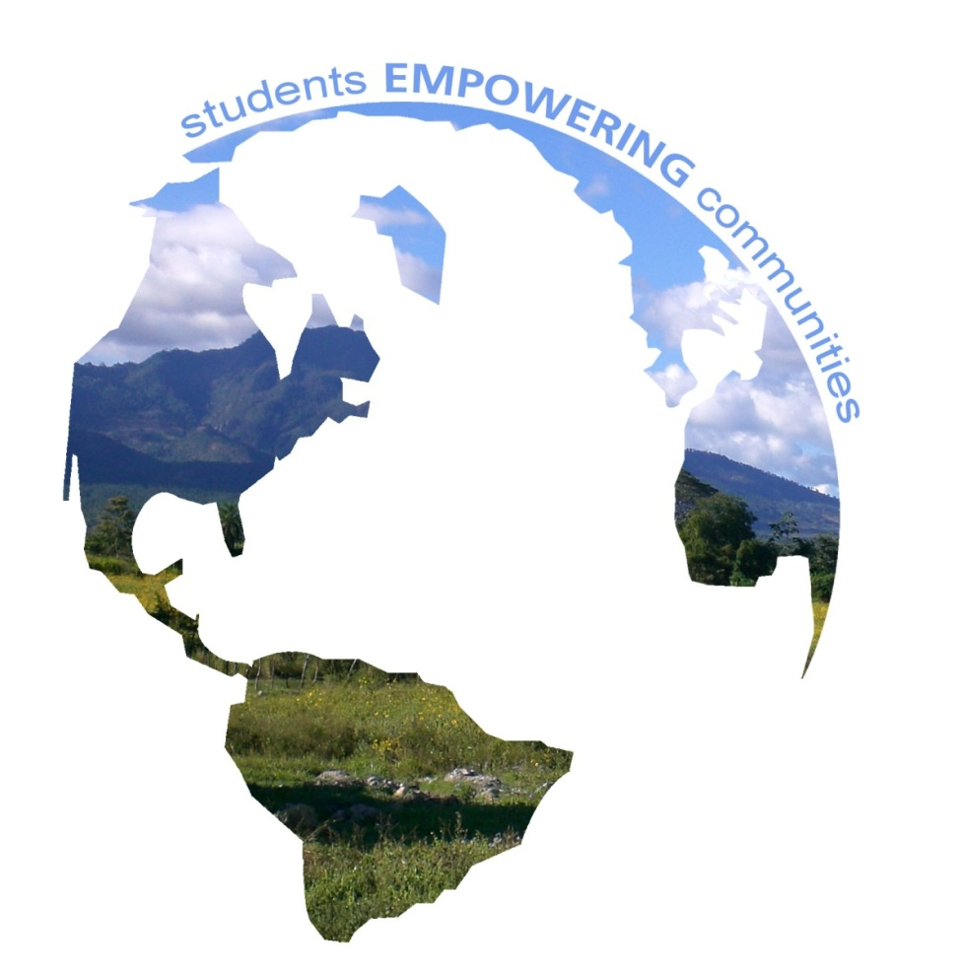
Global Brigades at IU
student-led international development
students EMPOWERING communities
www.globalbrigades.org

Slide 2
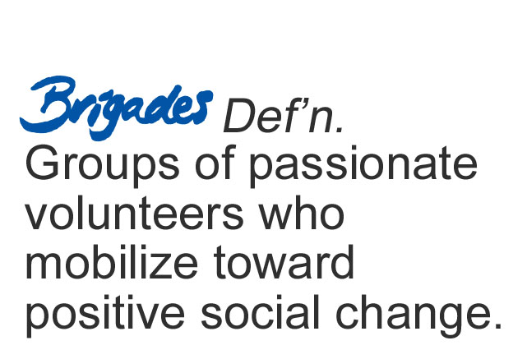
BRIGADES DEFINITION
Global Brigades, Inc. Copyright 2009

Slide 3
OUR VISION
VISION-International To create the world’s largest student-led movement for international sustainable development
VISION-On our campus
To create a well rounded, multidisciplinary student-run club dedicated to providing sustainable development solutions in Honduras and Panama
Notes:
STRAIGHT FROM BYLAWS:
The growing global economy has provided opportunity and affluence for those that can tap into it, but for many, opportunity is out of reach due to infrastructural gaps and access to resources. As a result, we are witnesses to a growing disparity of wealth and quality of health and education between the affluent sects of our global community and nearly everyone else. The disparity is most extreme in developing countries with infrastructural disadvantages that make them most at risk of experiencing a never-ending cycle of poverty, hunger and lack of health care.
In response to this disparity of quality of life, Global Brigades, Inc, (Global Brigades) intends to ignite the largest student-led social responsibility movement on the planet; with the mission to empower students to facilitate sustainable solutions in developing countries while respecting local cultures.

Slide 4
WHERE WE ARE NOW
Global Brigades is now one of the world’s largest student-led sustainable development organizations. Between 2008 and 2009, more than 5,000 volunteers from more than 100 GB university chapters in the U.S., Canada and U.K. traveled to provide health and economic development solutions to more than 50,000 beneficiaries with our teams in Panama and Honduras. Today Global Brigades is on more than 120 campuses worldwide.

Slide 5
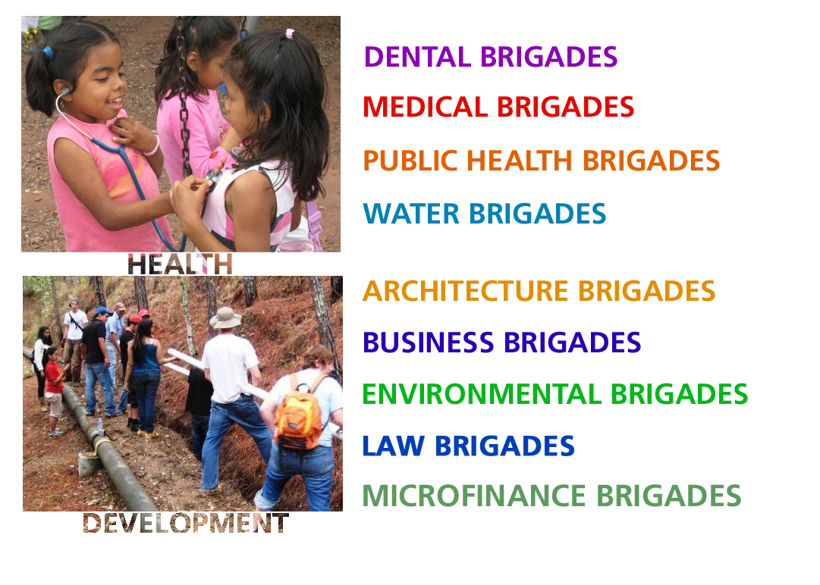
OUR MODEL
Global Brigades, Inc. Copyright 2009
A HOLISTIC MODEL FOR DEVELOPMENT
IN HONDURAS AND PANAMA
Our club will provide each community with access to:
clean water
medical and dental services
micro-loans
public health infrastructure
architectural planning
microenterprise consulting
legal empowerment
environmental protection
artistic empowerment
DANCE BRIGADES
Notes:
PROJECT SELECTION FOR DEVELOPMENT PROGRAMS: It is built on a partnership approach though an RFP process to identify communities and projects.
PROJECT SELECTION FOR HEALTH PROGRAMS: Typically the only service provider in the community, but empowering of local leadership to perpetuate programs.
The more clubs that start, the more communities we can affect and ultimately “exit.”

Slide 6
Spring accomplishments
DIRECT BENEFICIARIES:
16,771 patients were provided with medical care
104 people benefited by public health projects
125 homes benefited by water projects
28 new savings accounts and 32 potential new borrowers
50 members benefiting from a new sustainable structure helping their business
50 members provided with legal stability
200 members consulted on improving the efficiency and profitability of their business
PROJECTS:
69 Public Health projects were completed which includes pilas, hydraulic latrines, eco-stoves, and cement floors
1 complete dam, 3.2 km of conduction line, 6 km of distribution network, will now have 60gal.min of water entering the storage tanks during dry season
INVESTMENTS:
$13,500 invested in community businesses
$3,453 invested in community banks
$1,900 invested in building materials
$1,900 invested in legal contracts and workshops
TOTAL PEOPLE AFFECTED: 17,360

Slide 7
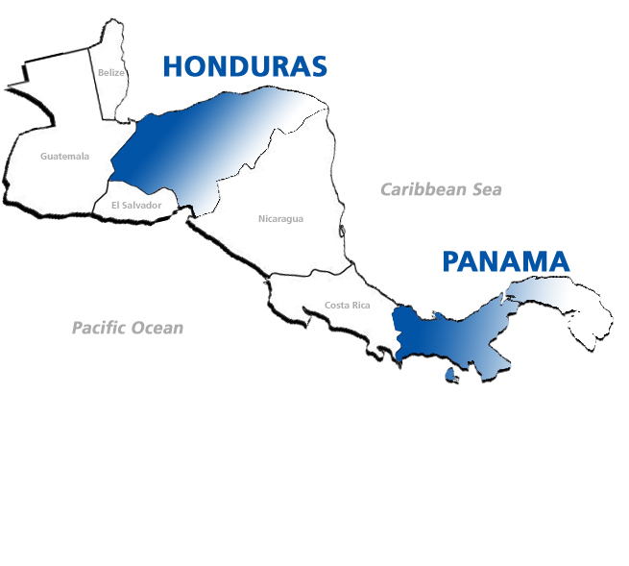
Global Brigades, Inc. Copyright 2009
Typical family income is less than
$2 per day
Typically no doctors within a 20 mile radius
Average level of education is
approximately 5th grade
Typical families have less than 3 gallons of water per day to use
Areas of high biodiversity at risk
of environmental degradation
Notes:
DID YOU KNOW?
Panama has the 4th highest wealth disparity in all of Latin America and 1st highest in all of Central America
For 2007, 56.8% of the unemployed Hondurans have done up to elementary school. The relationship between education-income per capita in a household is $53 for someone who has had elementary school education, while if the head of the family has received a superior education the income can be up to $391.
As of 2003, 49% of all Panamanians and 57% of all poor in Panama are citizens less than 20 years old increasing a dire need for more youth opportunity

Slide 8
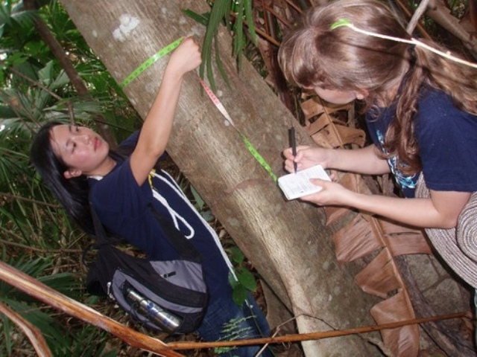
Environmental Brigades develops sustainable environmental solutions to preserve natural resources in bio-rich, but economically disadvantaged communities. In conjunction with local leaders and international organizations, student volunteers plan and implement projects that help communities develop sustainably and protect their future. Student projects include alternative energy solutions, reforestation and ecological preservation, environmental consulting to developing businesses and endangered species protection.
Notes:
Environmental Brigades develops sustainable environmental solutions to preserve natural resources in bio-rich, but economically disadvantaged communities. In conjunction with local leaders and international organizations, student volunteers plan and implement projects that help communities develop sustainably and protect their future. Student projects include alternative energy solutions, reforestation and ecological preservation, environmental consulting to developing businesses and endangered species protection. Currently, Environmental Brigades is only offered in Panama.

Slide 9
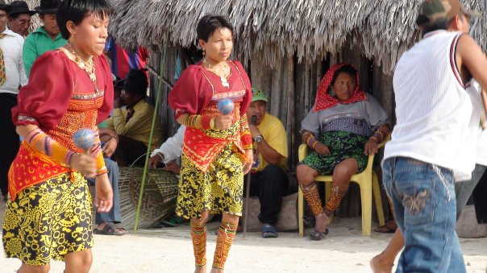
Dance Brigades uses movement and dance to empower youth in under resourced communities in the developing world. The brigade volunteers work with world-class instructors to empower disadvantaged youth to reach their potential with workshops and performances that they conduct. Dance is a global language that helps heal, improve self-esteem and body awareness, and is essential to cultural preservation and understanding. Global Dance Brigades is a cross-cultural movement that combines arts and global service!
Notes:
Environmental Brigades develops sustainable environmental solutions to preserve natural resources in bio-rich, but economically disadvantaged communities. In conjunction with local leaders and international organizations, student volunteers plan and implement projects that help communities develop sustainably and protect their future. Student projects include alternative energy solutions, reforestation and ecological preservation, environmental consulting to developing businesses and endangered species protection. Currently, Environmental Brigades is only offered in Panama.

Slide 10
PROGRAM COSTS
Global Brigades, Inc. Copyright 2009
$850 USD + Airfare
Included in program fee:
7 days and 6 nights program
Accommodations and meals
In-country transportation
Spanish translators and coordinators
Program sustainability and follow-up by in-country team
Community investment fund to perpetuate projects
Health insurance
Experience of a life time!

Slide 11
WHY GET INVOLVED
Global Brigades, Inc. Copyright 2009
An opportunity to learn:
Get real world experience in your field of interest
Challenge what you have learned in the classroom
Meet other students with similar interests and passions
Practice Spanish
See the beauty of Central America!
An opportunity to help:
Use your education and your resources to change lives
Provide basic resources and sustainable development projects that will help communities for generations to come
See how much you can get done in only one week
Past Brigaders: Share your stories and your experiences!

Slide 12
More about Environmental Brigades
3 PRINCIPLES
Work to support life-sustaining ecosystem services by preserving natural systems, protecting biodiversity, and recuperating degraded environments
Develop solutions that also protect natural resources and protect human health
Work alongside community members to promote sustainable practices

Slide 13
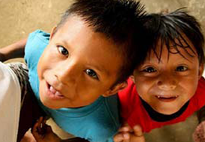
POPULATION
POPULATION
Indigenous people of Kuna
Rural Panamanian villages several hours outside of Panama City, Panama
0-14 years: 29.3%
15-64 years: 63.9%
65 years and over: 6.8%

Slide 14
COMMUNITIES
Incredibly isolated
Lack social services and communication with outside world
Lack financial resources
Overuse limited resources

Slide 15
ABOUT THE LAND
Youngest land in the Americas
Incredibly biodiverse
10,000+ varieties of plant
1000+ species of birds

Slide 16
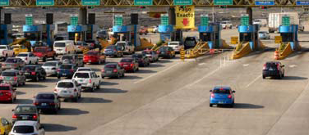
PROBLEMS
HUGE economic boom in 1999 ushered by the control of the Panama Canal
Brought producers and consumers from all over the world to the city
Unfortunately, no opportunities outside of the city

Slide 17
ENVIRONMENTAL PROBLEMS
Past:
3-10 million years ago = rise of isthmus
Pacific and Atlantic no longer touch
Water grew warmer
Present:
Deforestation
Flooding
Overuse of resources

Slide 18
PROJECT FOCUSES
Native species reforestation
Energy-efficient design including solar panels and compost toilets, eco-tourism, conducting studies, GPS mapping, recycling efforts, organic/sustainable agriculture capacitation
Building of an environmental education curriculum

Slide 19
ON-CAMPUS ACTIVITIES
Bi-weekly meetings
Each member will be given a responsibility
Development of education curriculum
Preparation for winter trip
Canning fundraisers twice a month
Big fundraiser once a month
Promotion of environmental problems to campus community

Slide 20
SPECIFICS ABOUT IU
Trip Date: January 1 – 7, 2011
Maximum capacity: 25 students
Final Online Registration Date and $20 deposit:
May 14th at 5:00 PM
First $250 deposit: September 29, 2010
Final payment: December 15, 2010

Slide 21
Fundraising
Hutton
Local rotary club
Pre-made letters on website
Facebook group

Slide 22
NEXT STEPS
Global Brigades, Inc. Copyright 2009
Fill out membership application
2. Deadline for website registration – May 14, 5:00 PM
First 25 people get spots
Make a $20 deposit by May 14

Slide 23
Iugeb.weebly.com
ARCHITECTURE.BUSINESS.DENTAL.ENVIRONMENT.LAW.MEDICAL.MICROFINANCE.PUBLIC HEALTH.WATER
www.globalbrigades.org

